Slide 1
Requirements
Lab zip (contains lab code and recordings)
Python 3 with numpy, scipy, matplotlib
Next slides provide steps to setup Python for Windows or browser-only

Slide 2

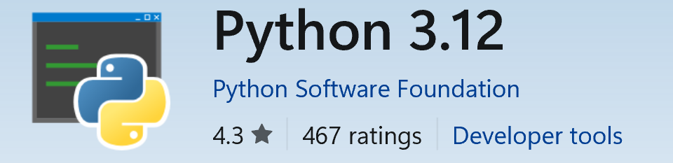
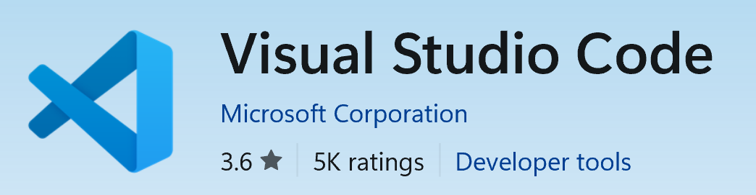
Windows Setup
Open Microsoft Store
Search for and install Python 3.12
Also search and install Visual Studio Code
Open VSCode app
Unzip the lab zip
File > Open Folder > choose the unzipped folder
Terminal > New Terminal > run the following command:
pip install numpy scipy matplotlib
Play button on the top-right can be used to run a Python script

Slide 3

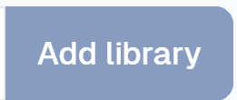


Browser-only (No-Install) Method
In a browser go to https://www.jdoodle.com/python3-programming-online
Copy the Python code for the lab into the browser text box
Click the button on the right, and add matplotlib and packaging
Run the code with
Note that the lab with the interactive slider app wont work
This icon on the right lets you upload the .npy recording files
TODO- THE LIMIT IS 1 MB SO MAKE SMALLER VERSIONS!

